Slide 1
Assignment - 2 Introduction to DEVOPS
Submitted by
Satish Kumar Sharma (2022MT93327)
1

Slide 2
Assignment 2 (Case Study)
A brand Product Development Company is failing to deliver their new product features to their customer. If this continues the company is expected to lose their customer base by 20% by 2021. Here are the challenges of company:
a) They still follow Nightly Build
b) Has Development Team spanned across Netherlands, America & India
Suggest the solution’s they can bring in to overcome the challenges and overcome the delivery backlog

Slide 3
Case Study Says
According to the case study, a brand product development company is struggling to deliver new product features to their customers due to nightly builds and the dispersion of the team across different global locations. The report cites several reasons for this failure, including ineffective communication among the team and current methods of implementation. Consequently, the company has lost 20% of its customer base. To prevent further loss of market share and customer loyalty, the company must identify the root cause of its problems and take proactive measures to address them. The following solutions address the challenges outlined in the assignment.
Please find the below solution in next page on the challenges mentioned in the assignment.

Slide 4
a) They still follow Nightly Build
To overcome the challenges and overcome the nightly Build, the company can consider the following solutions: Automate the Build Process, Use Version Control System, Implement automated testing, Use Deployment Pipeline and Monitor and Measure Performance.
Implement Agile Development Methodology: The company can switch from the nightly build approach to agile development methodology. Agile development is an iterative and collaborative approach that focuses on delivering working software frequently and efficiently. This approach can help the development team to prioritize and deliver features incrementally, which can reduce the delivery backlog.
Implement Continuous Integration and Continuous Delivery (CI/CD) pipeline: Instead of using Nightly Builds, the company can implement a CI/CD pipeline that automates the build, automated testing, and deployment Pipeline of their product, which can help them to detect and fix issues early on in the development cycle. This can help in reducing the turnaround time for feature delivery and improve the overall quality of the product.
Tools – Version Control, IaC, Azure DevOps, Jenkins, CircleCI, Team City, Docker, GIT, SonarQube.
Configuration Management tools: Chef, Ansible, Puppet and Salt
.

Slide 5
Continue...
3. Use DevOps practices: The company can consider implementing DevOps practices that enable better collaboration between development and operations teams. This can help in reducing the time to deploy new features and increase the reliability of the product.
4. Leverage Agile tools and technologies: The company can leverage agile tools and technologies to support their agile development methodology. These tools can help the development team to collaborate, manage their work, and track progress. This can help to improve transparency and reduce delivery backlog.

Slide 6
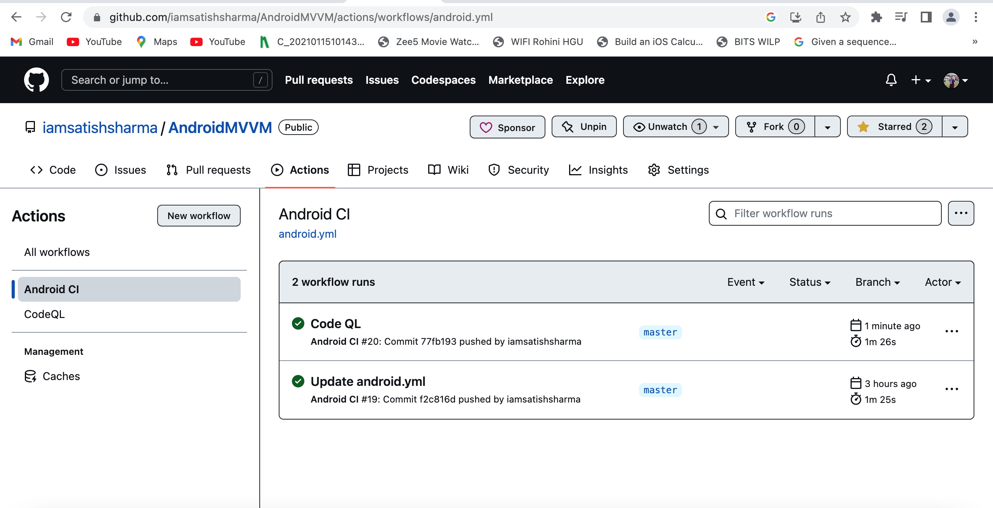
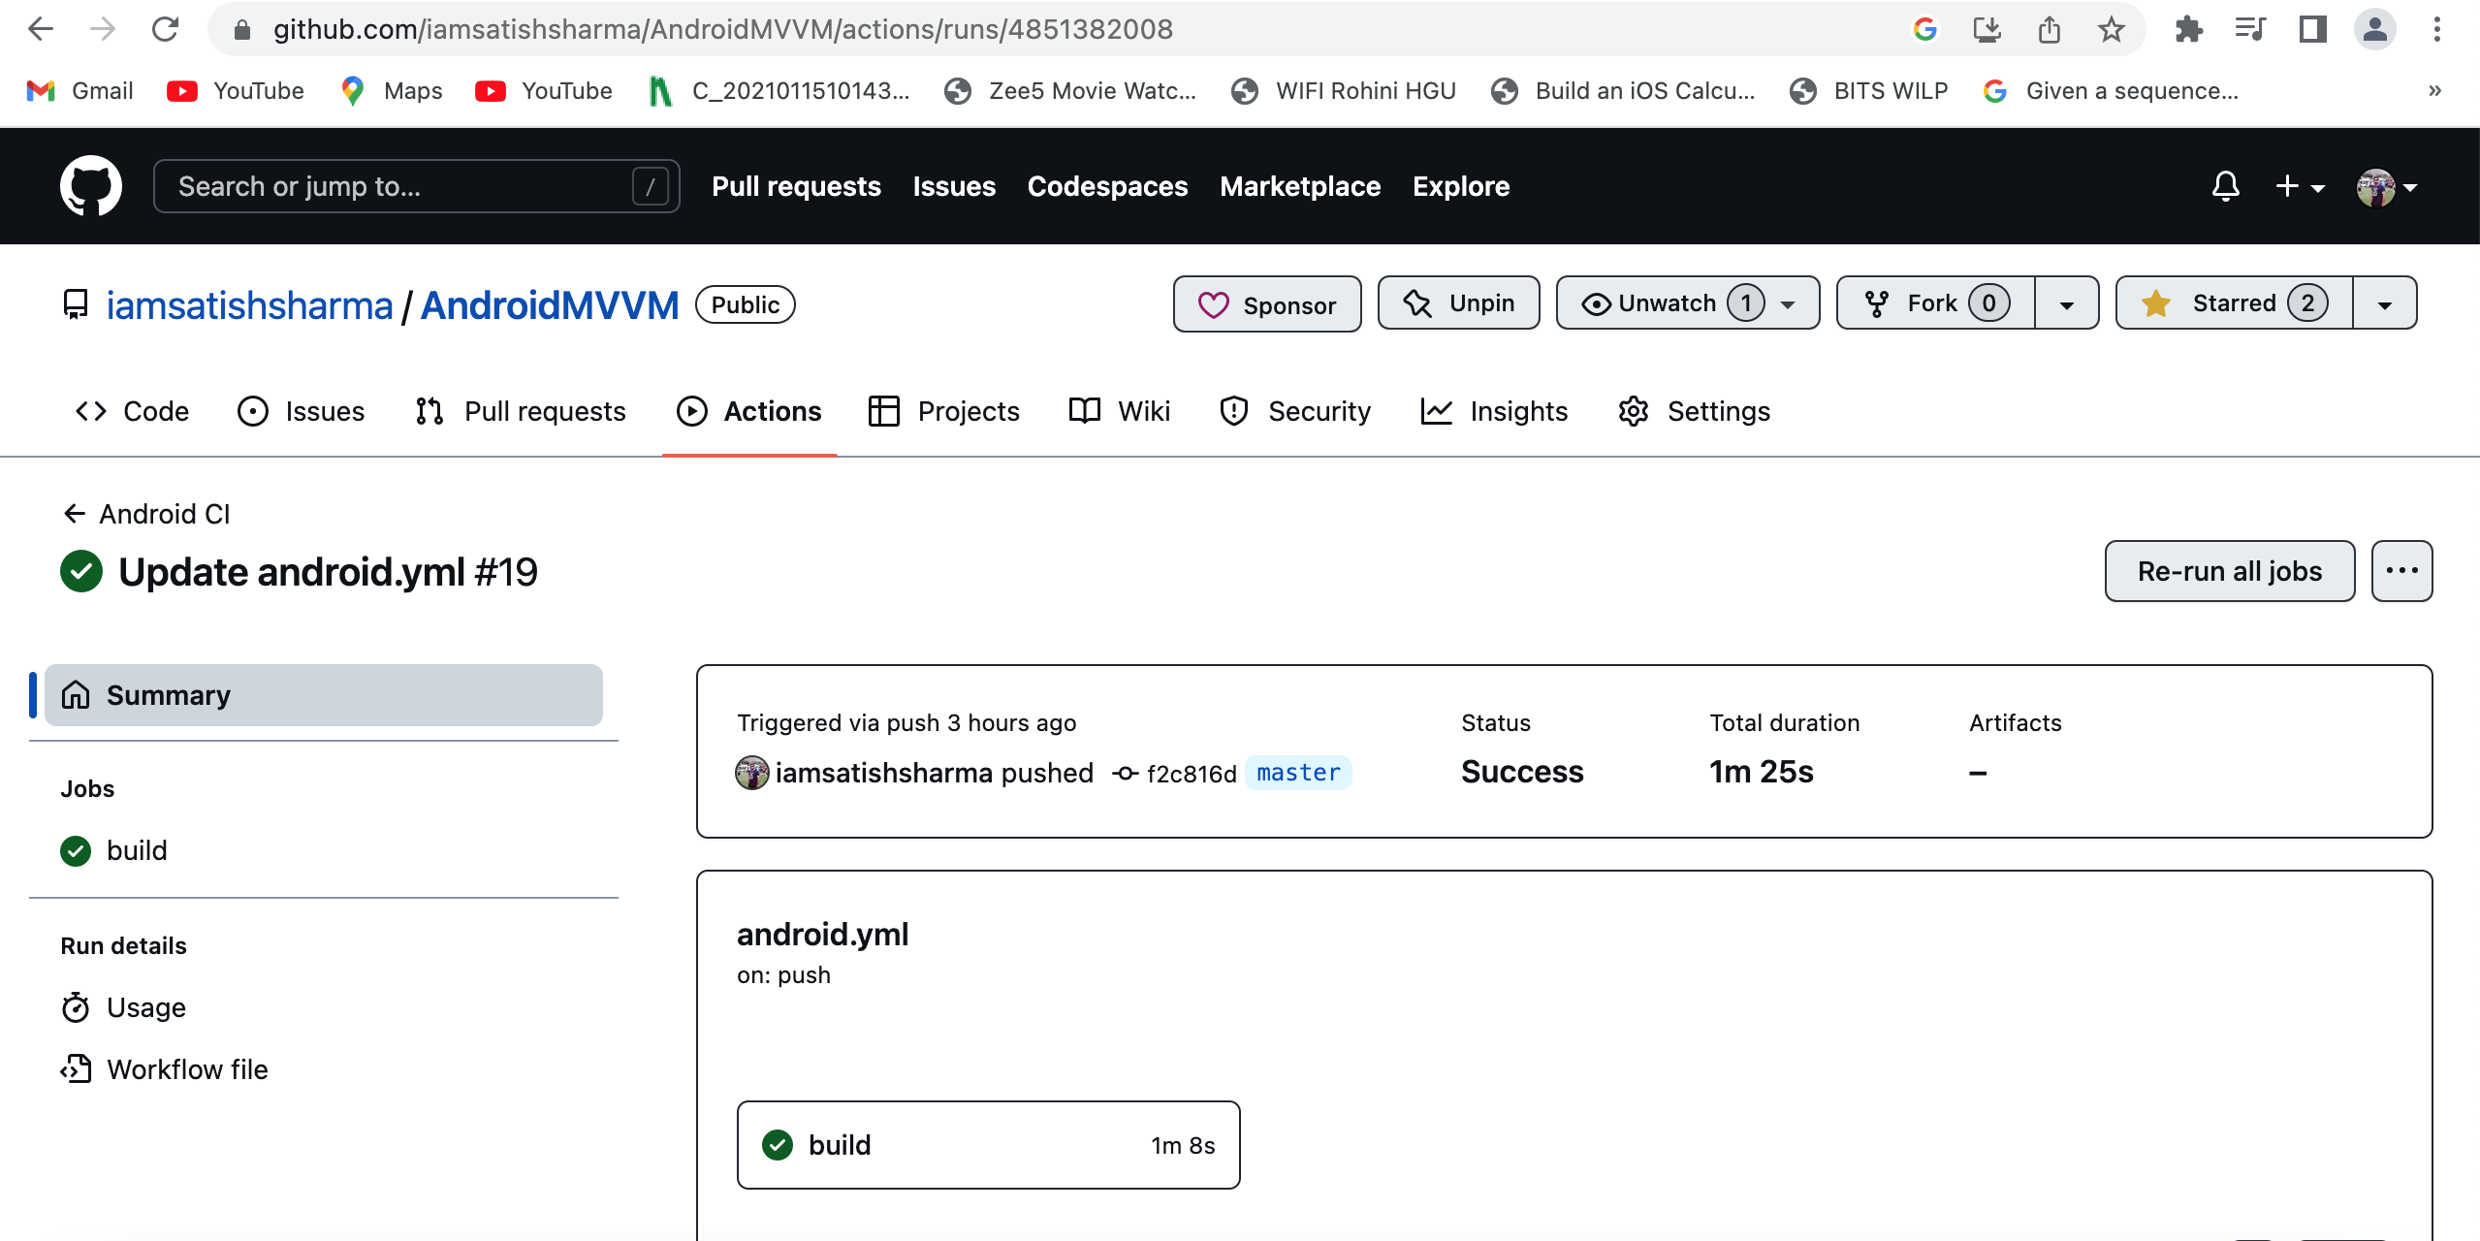
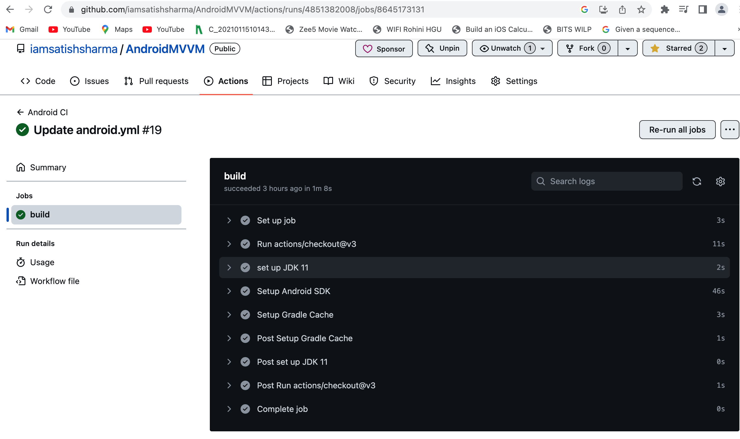
CI Pipeline Setup on my GitHub repository

Slide 7
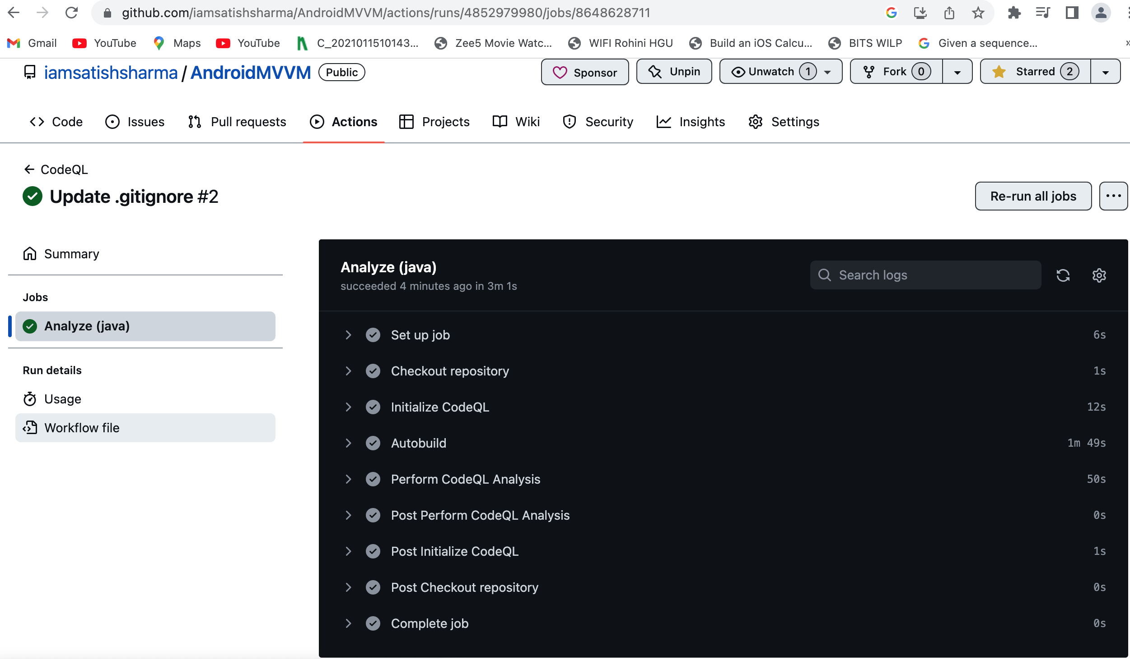
Job Run Successful - Screenshot

Slide 8
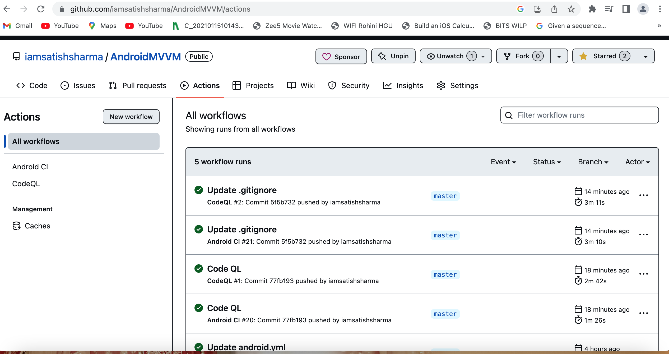
Workflow Run Successful Screenshot

Slide 9
b)Has Development Team spanned across Netherlands, America & India
Here are some potential solutions to overcome Development Team spanned across Netherlands, America & India
>Agile - scrum of scrum (safe) team is distributed 7-8 team member - for effective collaboration.
>Effective collaboration - MS teams, Slacks (for communication).
>Centralized knowledge base
>Code review (peer to peer)
>Video conference for better interaction – Zoom, MS teams
1. Adopt Agile methodologies: The company can consider adopting Agile methodologies such as Scrum or Kanban to improve collaboration and communication among the development team. This can help in breaking down the work into smaller, manageable chunks and prioritize the work based on customer needs.

Slide 10
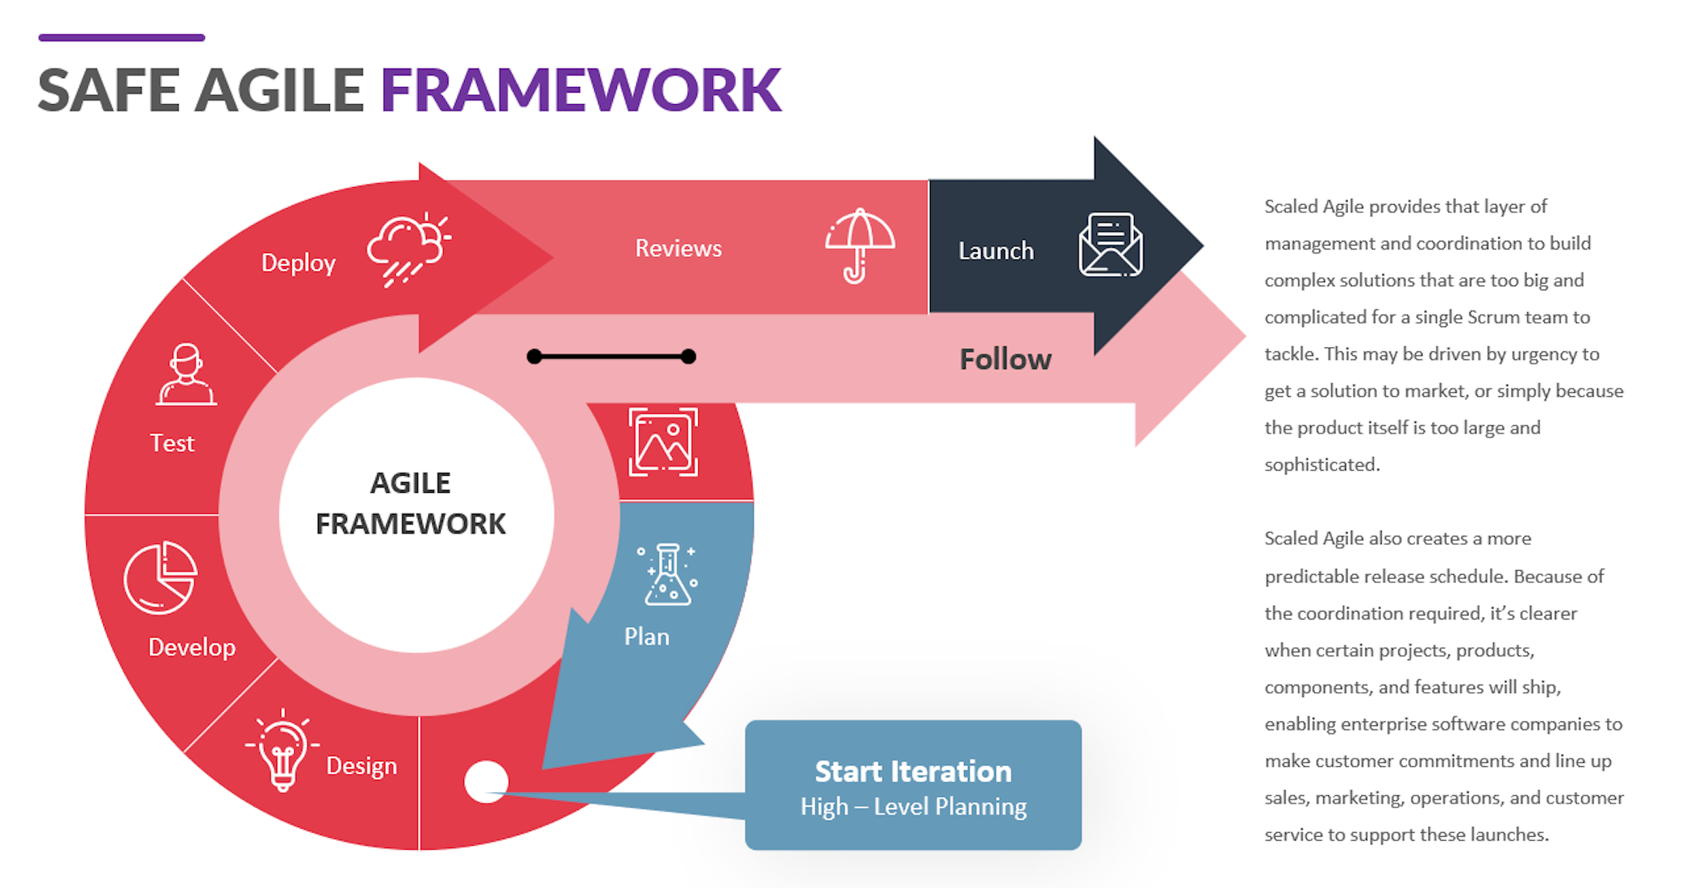
Continue…

Slide 11
Continue…
2. Implement effective communication channels: With a development team spanned across multiple geographies, effective communication channels are critical. The company can consider using tools like Slack, Zoom, or Microsoft Teams to facilitate real-time communication and collaboration among the team members.
3. Establish metrics for tracking progress: The company can establish metrics for tracking progress, such as lead time, cycle time, and throughput. This can help in identifying bottlenecks in the development process and continuously improving the delivery process.
4. Communication and Collaboration: The development team is spread across different countries, making communication and collaboration challenging. The company should invest in tools and technologies that enable the team to communicate and collaborate seamlessly. This could include using video conferencing tools, project management tools, and instant messaging platforms.

Slide 12
Continue…
5. Cross-Functional Teams: The company can form cross-functional teams that include members
from different geographies and functional areas. This approach will enable the company to bring
together the right mix of skills and expertise needed to deliver the features on time.
6. Establish a culture of continuous improvement: Finally, the company can establish a culture of continuous improvement to ensure that the team is always looking for ways to improve their processes and deliver better products. This can involve regularly reviewing the development process, identifying bottlenecks, and implementing changes to improve efficiency and reduce delivery backlog.
By implementing these solutions, the company can improve the delivery process,
overcome the challenges, and meet customer expectations, thus avoiding the loss of their customer base.

Slide 13
Key learnings
My key learnings are summarized as below:
I have also acquired knowledge on how to create DevOps workflows and incorporate dependencies in them.
Gained proficiency in the safe agile framework.
Furthermore, I have successfully configured a CI/CD pipeline for an android application, which I can now utilize for my workplace (Office projects).
Learned to create workflow and add dependency.

Slide 14
Thank You

